Slide 1
StepUp
Team: Triple-Threaded
Step up, team up, win together!

Slide 2


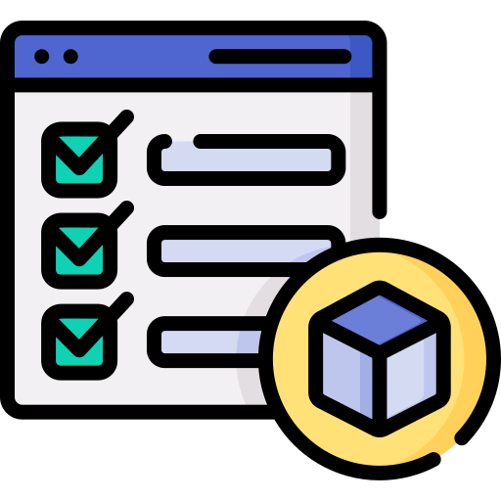
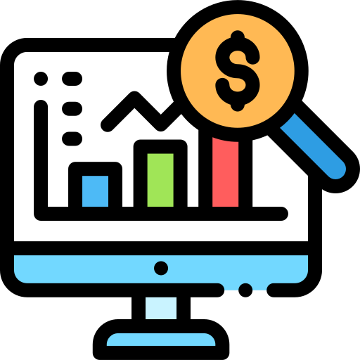
Problem Statement
Corporate Wellness s Team Engagement Problem Statement (DSIG 10)
AI-powered corporate wellness platform for employees to set wellness goals, track progress, and engage in team challenges.
Why it Matters:
Boosts morale, promotes movement, and strengthens workplace culture.
Data Sources s APIs:
Wearables APIs (steps, calories, activity logs)
Corporate HR data (optional)
Gamification APIs
Prototype Goal (Day 1–2):
Build leaderboard for a single wellness challenge (e.g., steps walked)
Step up, team up, win together!
Team: Triple-Threaded

Slide 3

The Problem
70% of employees feel workplace wellness directly impacts their productivity.
Corporate employees often have sedentary lifestyles → low energy, reduced focus
Engagement drops when wellness isn’t encouraged
Lack of fun wellness initiatives leads to weaker team bonding & lower morale
Step up, team up, win together!
Team: Triple-Threaded

Slide 4
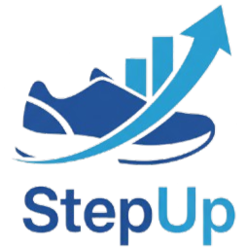
The Solution
An AI-powered corporate wellness app:
Step up, team up, win together!
Team: Triple-Threaded

Slide 5
Why StepUp?
Step up, team up, win together!
Team: Triple-Threaded

Slide 6
The Solution
An AI-powered corporate wellness app:
GOALS
PROGRESS
TEAM SPIRIT
Employees can set personal wellness goals (steps, activity, calories)
Track steps & activity with real-time updates on the leaderboard.
Join team challenges to encourage collaboration & fun competition.
Step up, team up, win together!
Team: Triple-Threaded

Slide 7
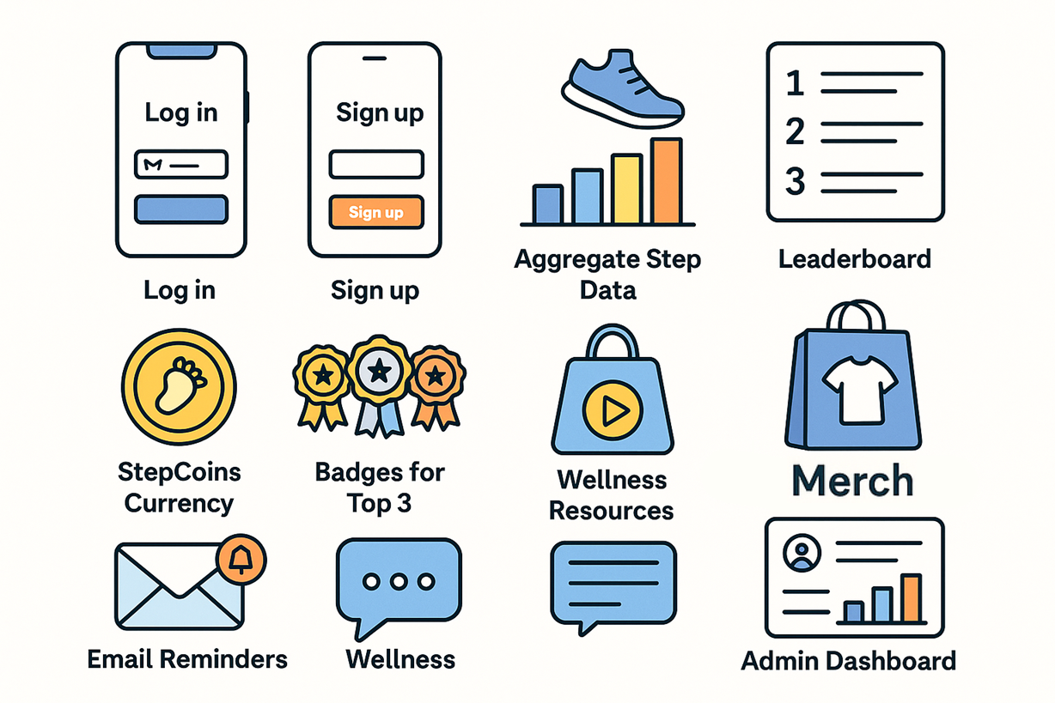
FEATURES
Step up, team up, win together!
Team: Triple-Threaded

Slide 8
Core Features
Login & Signup
Simple onboarding for employees to join challenges.
Aggregate Step Data
Collects activity data (manual or via wearables)
Leaderboard + Badges
Ranks employees, top 3 earn special badges.
Step up, team up, win together!
Team: Triple-Threaded

Slide 9
Engagement Features
StepCoins Currency
Virtual points earned from steps and consistency.
Redeem for Merch
StepCoins can be exchanged for rewards or goodies.
Email Reminders
Gentle nudges to keep employees active & consistent.
Push-up Counter
AI-powered push-up tracker using webcam—counts reps in real time, making workouts fun and accountable. Convert push-ups to StepCoins.
Step up, team up, win together!
Team: Triple-Threaded

Slide 10
Advanced Features
Wellness Resources
Access to Steppy, a wellness chatbot, tips, and curated health videos.
Admin Dashboard
HR can track participation & wellness progress.
AI Progress Review
Personalized feedback to improve employee health.
Step up, team up, win together!
Team: Triple-Threaded

Slide 11
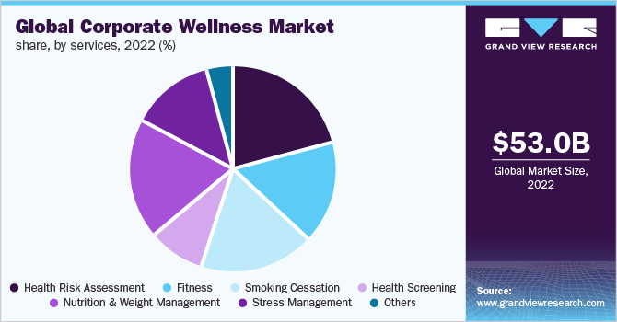
Market Landscape & Competitor Comparison
Step up, team up, win together!
Team: Triple-Threaded

Slide 12
Market Snapshot
Global Market Growth
Regional Highlights
The corporate wellness market is booming — valued at USD 70.6 B in 2024 and expected to double to USD 128 B by 2033 (6% annual growth). Platforms alone are set to jump from USD 2.7 B to USD 7.5 B (12% CAGR).
North America leads (~40% market share)
Europe is strong and rising
Asia-Pacific is the fastest-growing region (APAC projected ~9% CAGR; India ~9.5%)
Step up, team up, win together!
Team: Triple-Threaded

Slide 13
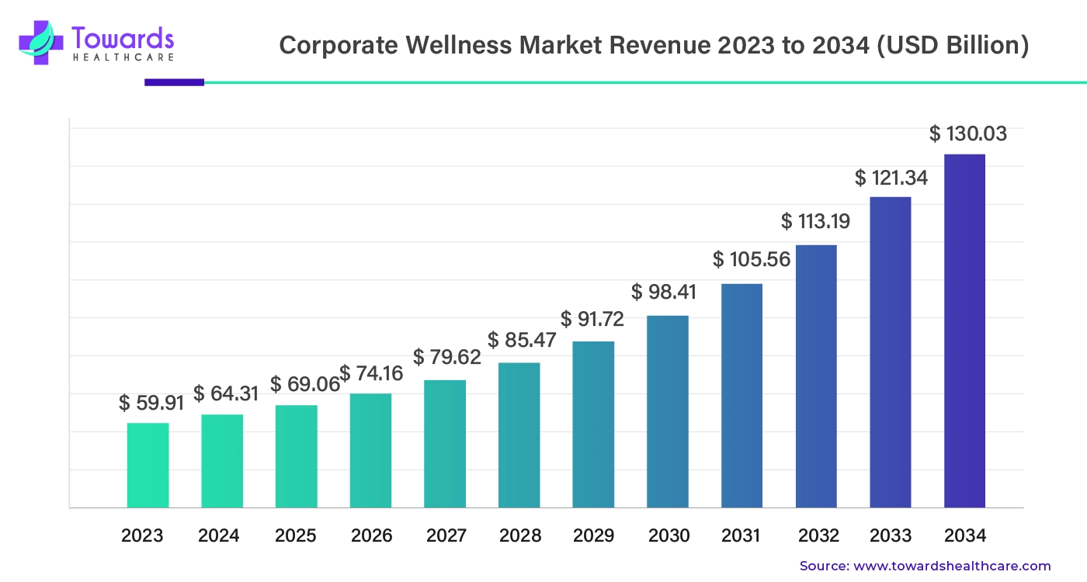
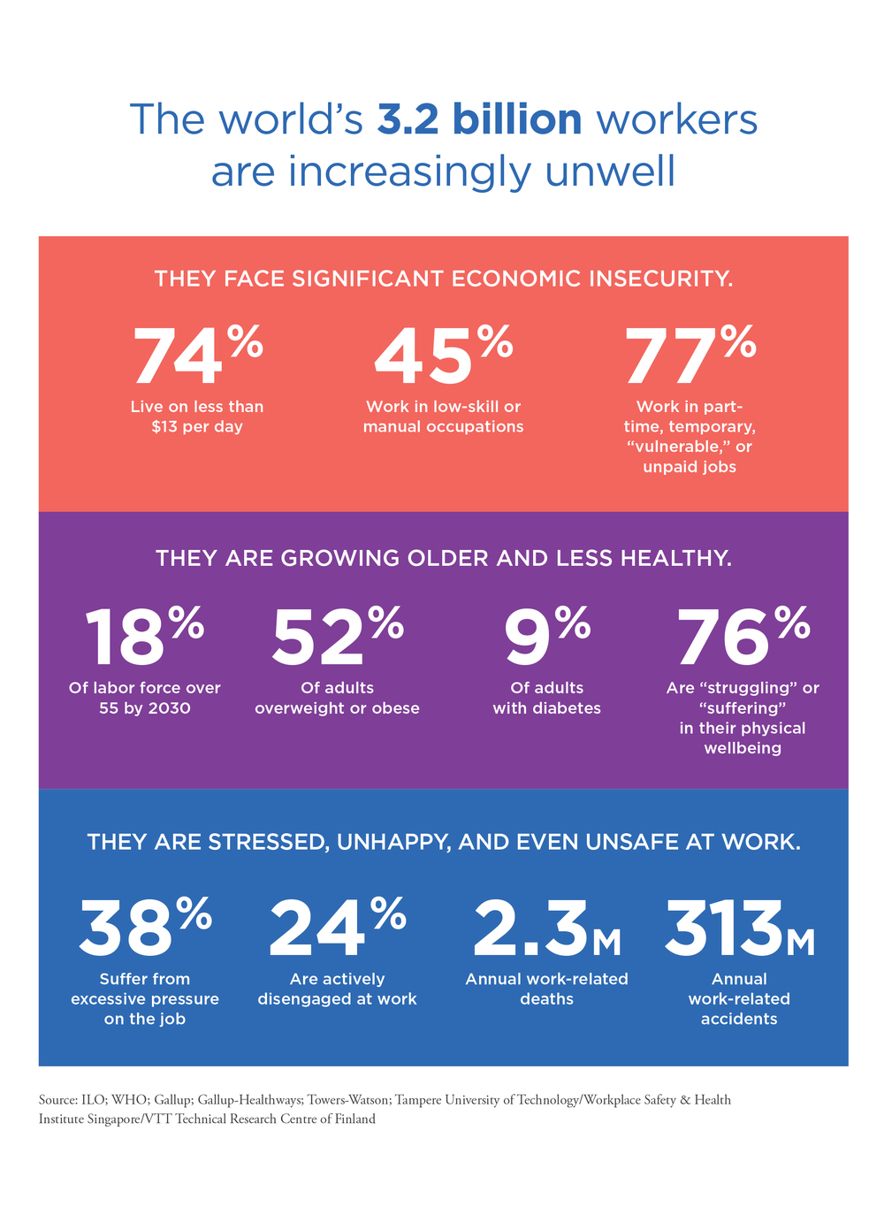
Why Now? (Growth Drivers)
Employers see up to 30% healthcare cost reduction with wellness programs.
Millennials and Gen Z are recession-resistant spenders on fitness—spending on fitness centers rose 7% YOY.
AI, wearables, and gamified engagement are transforming wellness platforms—growth matches our feature direction.
Step up, team up, win together!
Team: Triple-Threaded

Slide 14
Competitor Landscape
Top Competitors | Strength/Focus
Virgin Pulse | Holistic well-being (physical, mental, social)
Limeade | Well-being and inclusion + positive workplace culture
Welltok | Data-driven personalized health recommendations
ComPsych | Employee assistance & behavioral health services
Step up, team up, win together!
Team: Triple-Threaded

Slide 15
WHY ARE WE BETTER?
Gamification with StepCoins
Wellness Resources (Chatbot + Videos)
Competitors usually stop at tracking + leaderboards.
Our app adds a reward economy (StepCoins) → people feel a sense of achievement AND can redeem them.
Most apps focus only on “steps.”
Ours gives holistic wellness: quick chatbot for instant motivation, curated videos/resources for healthy habits.
AI Profile Review
Community Leaderboard
Competitors: generic insights.
Ours: personalized AI feedback → tells users where they’re slacking, what they’re excelling at.
Leaderboards exist everywhere, but we’ll highlight top 3 badges + streaks so there’s social recognition beyond just a number.
Step up, team up, win together!
Team: Triple-Threaded

Slide 16
WHY ARE WE BETTER?
Gamification with StepCoins
Wellness Resources (Chatbot + Videos)
Competitors usually stop at tracking + leaderboards.
Our app adds a reward economy (StepCoins) → people feel a sense of achievement AND can redeem them.
Most apps focus only on “steps.”
Ours gives holistic wellness: quick chatbot for instant motivation, curated videos/resources for healthy habits.
AI Profile Review
Community Leaderboard
Competitors: generic insights.
Ours: personalized AI feedback → tells users where they’re slacking, what they’re excelling at.
Leaderboards exist everywhere, but we’ll highlight top 3 badges + streaks so there’s social recognition beyond just a number.
Step up, team up, win together!
Team: Triple-Threaded

Slide 17
StepUp
Technical
Details
Step up, team up, win together!
Team: Triple-Threaded

Slide 18

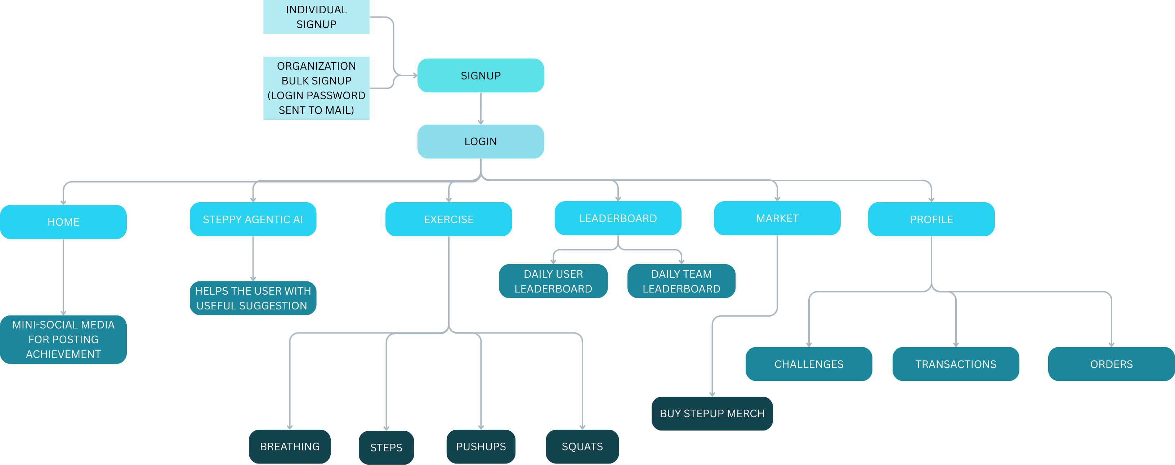
WEBSITE STRUCTURE
Step up, team up, win together!
Team: Triple-Threaded

Slide 19
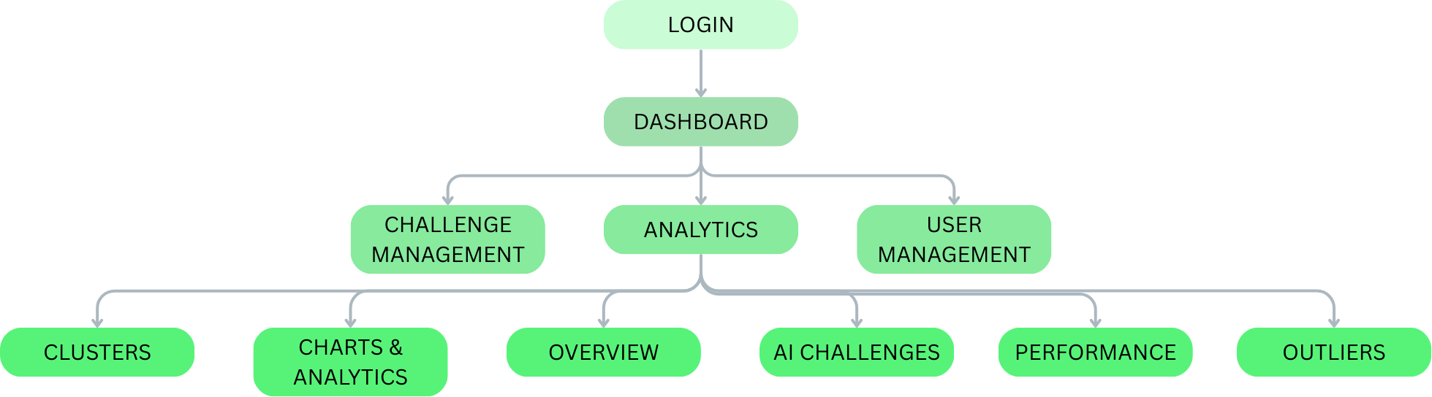
ADMIN API STRUCTURE
Step up, team up, win together!
Team: Triple-Threaded

Slide 20
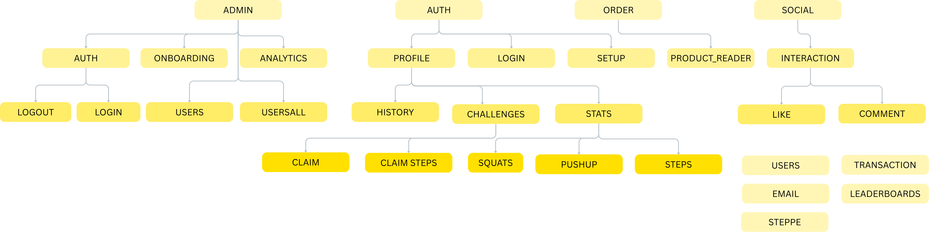
API STRUCTURE
Step up, team up, win together!
Team: Triple-Threaded

Slide 21
DATABASE STRUCTURE
Step up, team up, win together!
Team: Triple-Threaded

Slide 22
Thank You!
CONTRIBUTORS
01
02
03
Step up, team up, win together!
Subhayan Niyogi
Parnika Sen
Souptik Dam
Team: Triple-Threaded

